Slide 1
Blue-Mart E-Commerce Solutions Customer Behaviour Analysis
Objective: Enhancing marketing and engagement through insights
Key Trends and Actionable Strategies

Slide 2
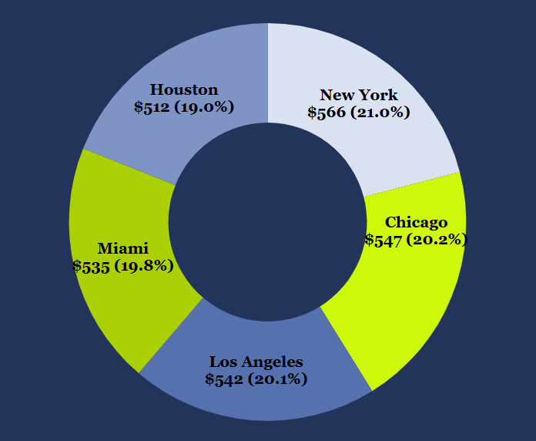
BUYING PATTERNS
Key Metrics and Observations:
Average Order Value = $540
Highest in New York, $566 - market for premium-priced goods.
Lowest in Houston, $512 - price-sensitive buyers.

Slide 3
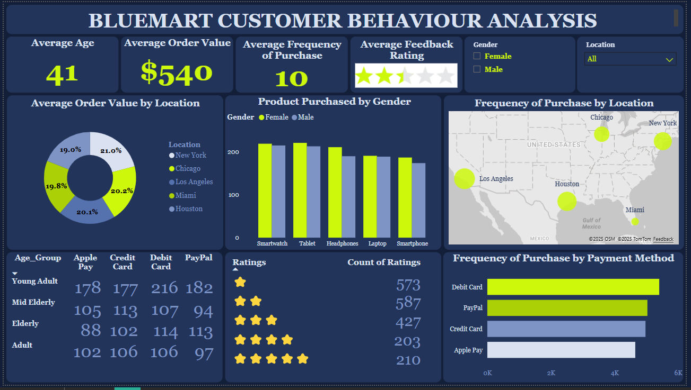
BUYING PATTERNS
Key Metrics and Observations:
Product Preferences by Gender:
Purchases are nearly balanced across genders.
Females slightly favour tablets, headphones, and smartphones.
Marketing these products as tech-savvy and versatile could resonate more with women.

Slide 4
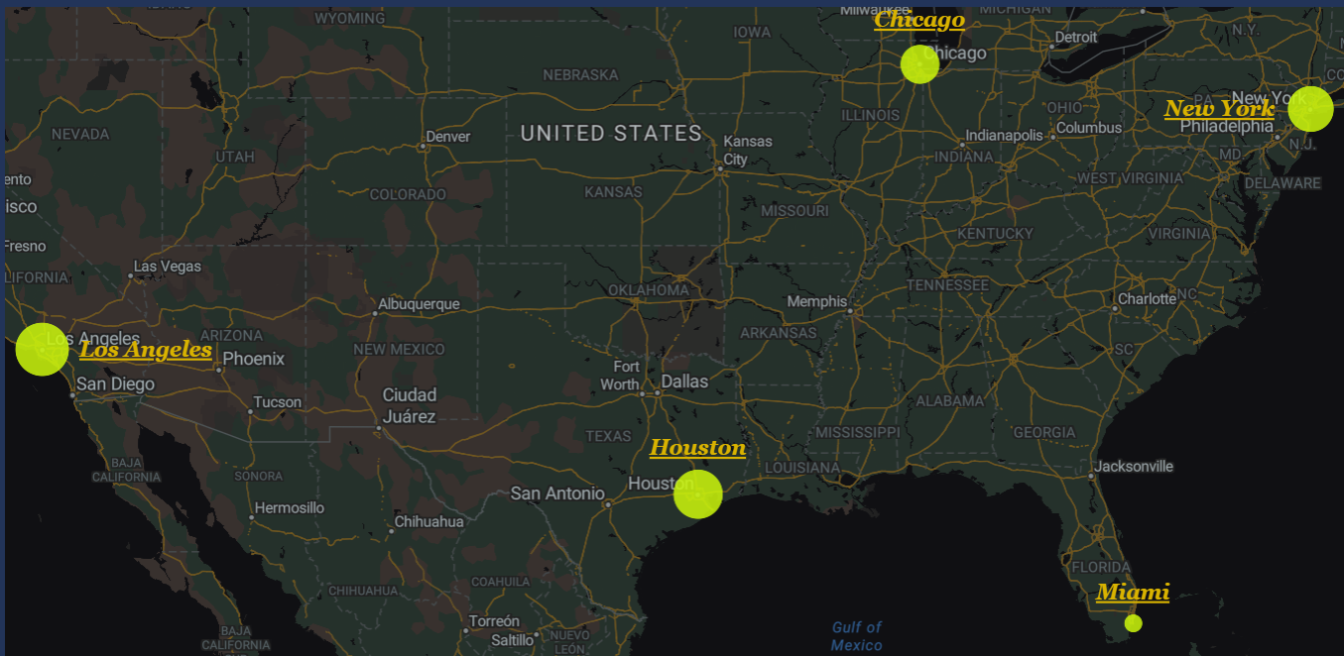
3907
4057
4267
4145
3691
BUYING PATTERNS
Key Metrics and Observations:
Frequency of Purchase:
Highest activity in Los Angeles (4267) and Houston (4145)
High engagement in these areas could indicate strong loyalty or marketing effectiveness
We should target these regions for upselling or cross-selling.
boost engagement, build trust, and expand reach in other areas

Slide 5
CUSTOMER PREFERENCES
Insights:
Age-Based Payment Methods:
Young Adults (18-34): Apple Pay, Debit Cards Digital-first payment solution resonates more with this Tech-savvy group.
Mid-Elderly (45-54) and Elderly (55+): Debit Cards, PayPal This age group would normally require security in payments
Adults (35-44): Balanced payment methods across indicating an openness to diverse methods

Slide 6
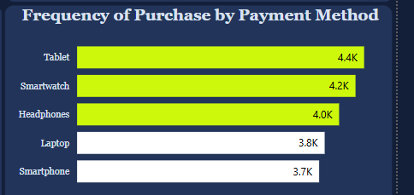
CUSTOMER PREFERENCES
Insights:
Product Mix:
Tablets and Smartwatches are top sellers.
Highlights interest in portable, multifunctional devices—emphasise their practical and stylish features in promotions.

Slide 7
RETENTION STRATEGIES
Challenges & Recommendations:
Feedback Ratings:
Average rating: 2.44/5 (majority ratings at 1-2 stars)
Action Plan: Address pain points through surveys and loyalty initiatives.
Implement loyalty programs or engagement surveys to understand and address customer concerns.

Slide 8
RETENTION STRATEGIES
Challenges & Recommendations:
Geographic Opportunities:
Miami (lowest purchase frequency): Consider localised promotions.

Slide 9
RETENTION STRATEGIES
Challenges & Recommendations:
Incentivising Payment Methods:
Focus on Debit Card users (highest purchase frequency)
Incentivisation through cashback or rewards to bolster loyalty.

Slide 10

STRATEGIC ENHANCEMENTS
Recommendations:
Target Areas:
Premium campaigns for New York and Los Angeles
Affordability-focused offers for Houston.
Customer Experience:
Feedback-driven product/service improvements. Use surveys and direct customer interaction to improve ratings.
Payment Promotions:
Tailored campaigns for demographic preferences (e.g., ApplePay perks for younger customers).

